Slide 1


CAPSTONE PROJECT REVIEW TEAM – 5 ARTIFICIAL INTELLIGENCE ( AI )

Slide 2


Music Recommendation System - using Python
Project Title :
Objective of project :
The objective of this project is to develop a machine learning model to give user the songs they will listen to i.e., build a music recommendation system based on content based and collaborative filtering.
TEAM MEMBERS :
01
18K41A0599
02
18K41A0596
03
GUIDE :
Mr . D RAMESH
18K41A0536
04
18K41A04C3

Slide 3

INTRODUCTION!
Nowadays, we all use online music streaming services like Spotify, Jio Saavn, Gaana, etc. Do you know, how you get song recommendations from them according to your choice???
This is because these services use machine learning models to give you the songs they think you will listen to.

Slide 4
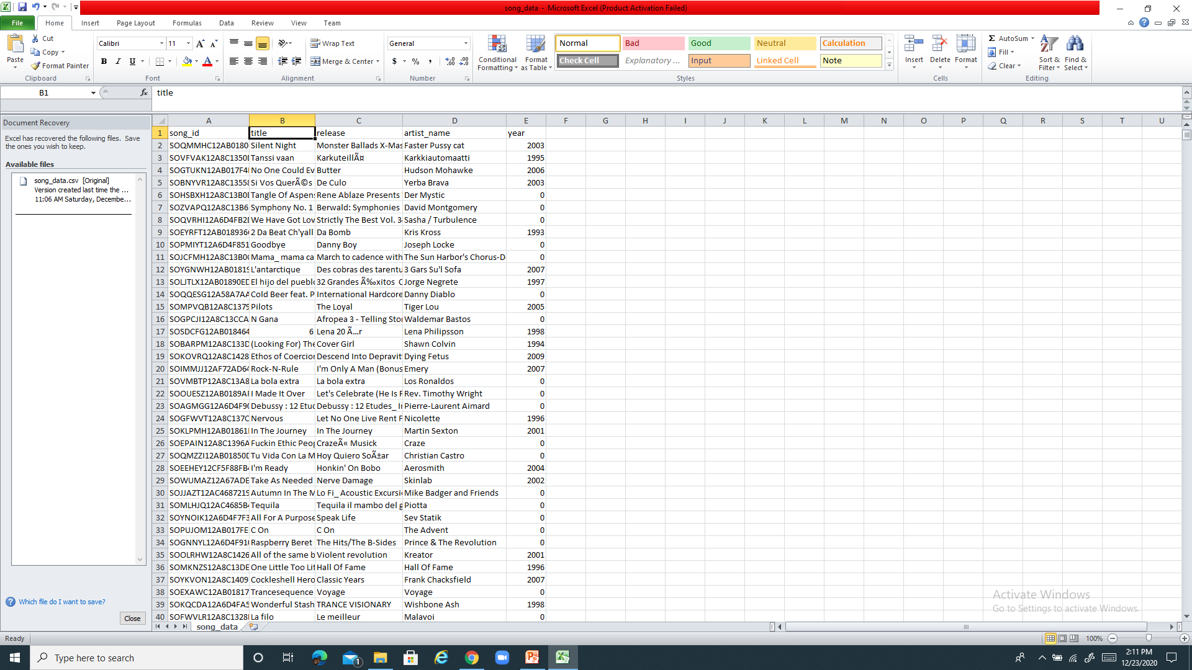
DATA SET :
We have 2 Datasets
CSV file contains songid, title, release, artist name, release year

Slide 5
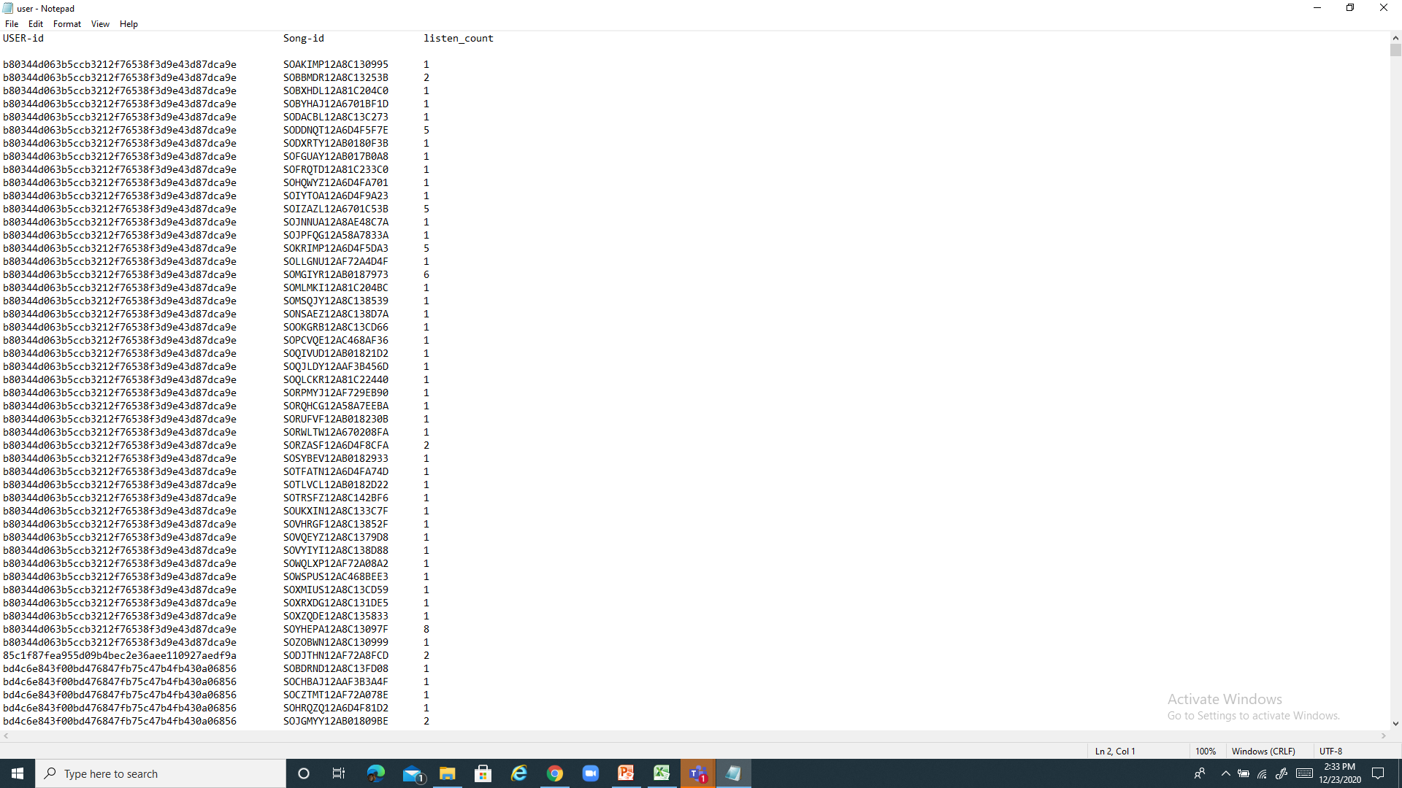
Static turi.com( DATA SET SOURCE) 2. Txt file containing table of userid, songid, listen count

Slide 6
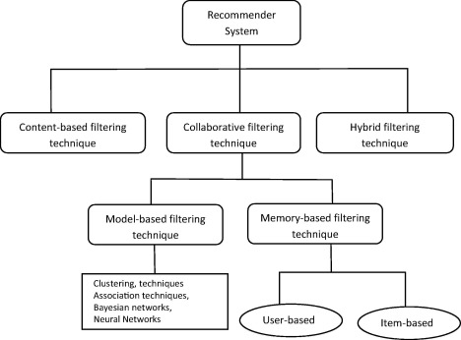
PROCEDURE
We use different machine learning model to solve our classification problem:
Content-based filters
Collaborative filters
K-Nearest Neighbors (KNN)
matrix factorization approach.

Slide 7
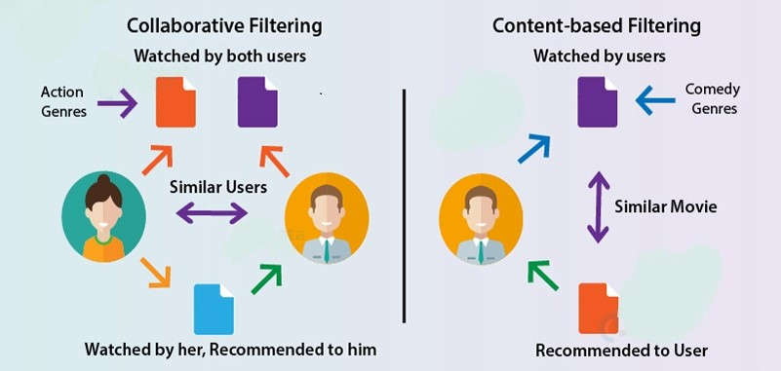
PROCEDURE
Figure : Difference in processing of content based and collaborative based filtering\

Slide 8
PROCEDURE
Content-based filters :
Recommendations developed using this filters method are user-specific classification problem. This classifier knows what the user wants and does not like the features of the song.
The most simple solution is matching keywords. The idea behind this is to extract important keywords which are present in a song description that the user likes very much, to look for keywords in other song descriptions to approximate the similarities between them and, on that basis, to recommend those songs to the user.
How is this done?
approach is keyword matching match lyrics of new songs with songs listened by user ,to do that we need to follow 2 steps
1. extract basic or signature lyrics of song ( we use TfidfVectorizer from sklearn)
Tfidfvectorizer converts collection of raw documents to matrix of TF-IDF features ,which will be input for cosine similarity
2. match those lyrics with new songs and recommend if they are similar (we use cosine similairty from sklearn)
Term Frequency-Inverse Document Frequency (TF-IDF) is method we follow which extract information as matrix from sentence here it is song

Slide 9
PROCEDURE
K-Nearest Neighbour (KNN) :
Collaborative Filters work with an interaction matrix, also called rating matrix. The purpose of this algorithm is to learn a feature that can predict when a user would benefit from an object-meaning that the user is likely to order, listen to, and watch this item.
There are 2 types of collaborative-based recommendation systems:
user-item filtering and
item-item filtering.
There are several machine learning algorithms that can be used for collective filtering. Among them, we can list the nearest-neighbor, clustering, and matrix factoring.
K-Nearest Neighbors (kNN) is considered a standard framework for collaborative filtering approaches based on both the recipient and the object.
There are two files that will be interesting for us. The first of them will give us information about the songs. Particularly, it contains the user ID, song ID and the listen count. On the other hand, the second file will contain song ID, title of that song, release, artist name and year. We need to merge these two DataFrames. For that aim, we'll use the song_ID

Slide 10
PROCEDURE
K-Nearest Neighbour (KNN) :
We can visualize from calcualtions in code that not all user listen to all songs, so a lot of values in the song x users matrix are going to be zero. Thus, we’ll be dealing with extremely sparse data. The matrix of users x songs has 728469151 values (from model we generated ) that are zero
Dealing with such a sparse matrix, we'll take a lot of memory and resources. To make our code simpler, select all those users that have listened to at least 16 songs.
We need now to work with a scipy-sparse matrix to avoid overflow and wasted memory. For that purpose, we'll use the csr_matrix (compressed sparse row)function from scipy.sparse.
csr matrix is used to represent sparse matrix (matrix with most of the values 0 )
We apply knn algorithm for data along with cosine rule
Cosine similairtyis used to find euclidean distance using cosine angle between two points
We can take k points which are closer (having less euclidean distance from user listened song point) to the song user listened
In knn recommendation class we actually send song title as input but we need to do knn algorithm for song ids so we use fuzzywuzzy module which is used for string matching by this we get song id using title
By using this song id we get recommended song ids and then we need to translate this ids into song titles and send those as output

Slide 11
PROCEDURE
Matrix factorization method (using SVD) :
We're going through the steps to create a music recommendation framework. We're going to use a matrix factorization method this time.
Once again, we will use the Million Song Dataset, a freely distributed catalog of audio attributes and metadata for a million contemporary popular music songs that we used for the KNN methodology
Matrix Factorization is a strong means of applying a recommendation framework. The concept behind this is to represent users and objects in a latent space , lower-dimensional space.
In other words, matrix factorization methods decompose the original sparse user-item matrix into smaller, less sparse rectangular matrixes with latent functionality.
This not only solves the problem of sparsity, but also makes the process scalable. No matter how large the matrix is, you will still find a lower dimensional matrix that is a true reflection of the original matrix.
Among the many matrix factorization techniques, we considered the popular SVD where svd : singular value decomposition
This may be an abstract term as we expand our comprehension of the mathematical foundations. But we're going to try to make things as easy as possible. Imagine that we have a matrix A that contains data for n users x m songs.. This matrix can be decomposed into three matrixes only; let's name them U, S, and V.

Slide 12
PROCEDURE
Where :
U is a n user x r user-latent function matrix
V is a m song x r song-latent function matrix
S is a non-negative diagonal matrix of r x r containing the singular values of the original matrix.
Instead of dealing with the ranking as it is, we can use the binning method.
Binning method : used for smoothing data or to handle noisy data (here, it is sparse data), in this method data is first sorted and sorted values are distributed into number of bins(here , we consider 10 categories or bins)
We will classify all of them into 10 classes. The original data values that fall within the range of 0 to 1 will fall into rating of 1; if they fall within the range of 1 to 2, they will be replaced by 2; and so on. The last category will be assigned to the original values ranging from 9 to 2213
We'll use the built-in function for SVD. First, a set of parameters is going to be defined to search for the best parameters for the model.
The GridSearchCV class will compute accuracy metrics for the SVD algorithm on the combinations of parameters selected, over a cross-validation procedure. This is useful for finding the best set of parameters for a prediction algorithm.

Slide 13
PROCEDURE
Cross-validation is technique for evaluating ML models by training several ML models on subsets of available input data and evaluating them on complementary subset of data
After finding the best parameters for the model, we create our final model, train it and find the error for the test set.
We got RMSE as 2.1781

Slide 14
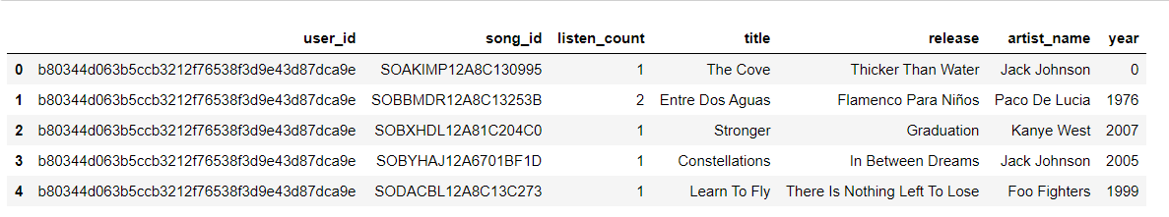
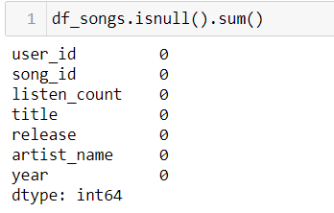
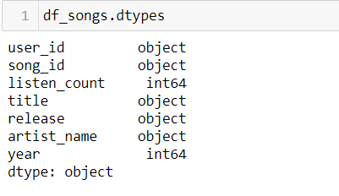
RESULTS
Data Processing :
Cleaning of data :
we should perform some cleaning steps. But looking at the dataset, we can see that there is no missing values. And most of the columns contain strings
Figure : After merging user data and songs data

Slide 15
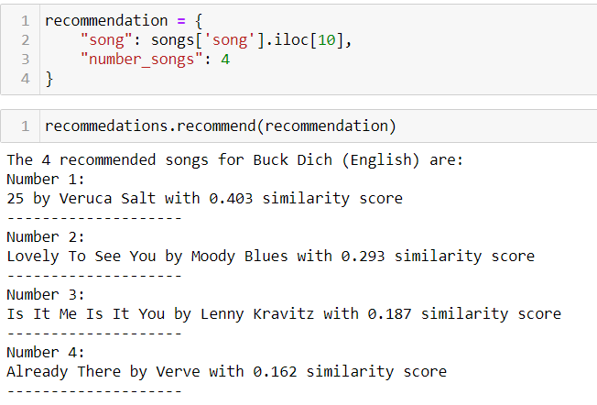
RESULTS
Content-based filters :
We pick random song from dataset and test it

Slide 16
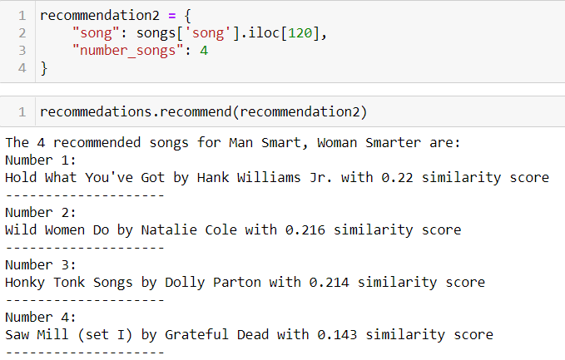
RESULTS
Content-based filters :
Another random songs picked

Slide 17
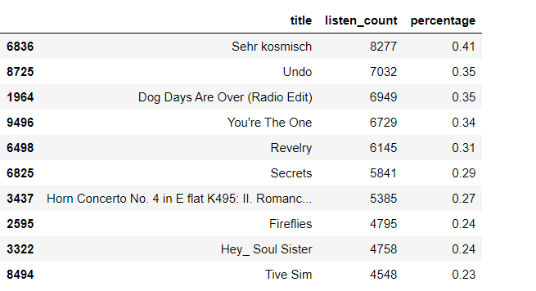
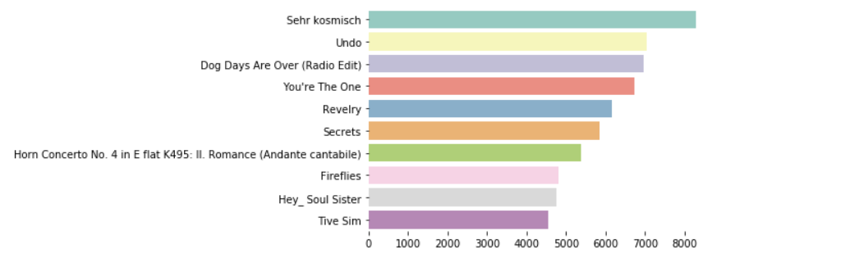
RESULTS
K-Nearest Neighbour (KNN) :
Popular songs :

Slide 18
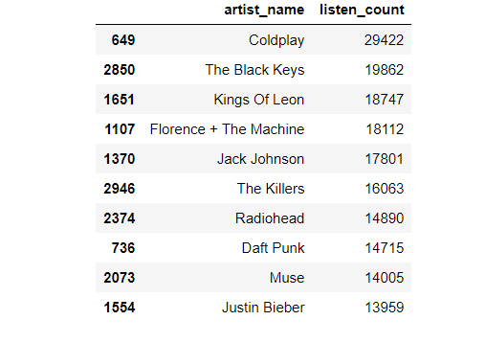
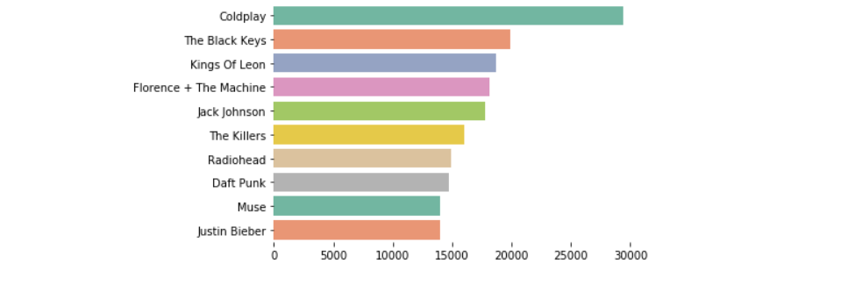
RESULTS
Popular artists :

Slide 19
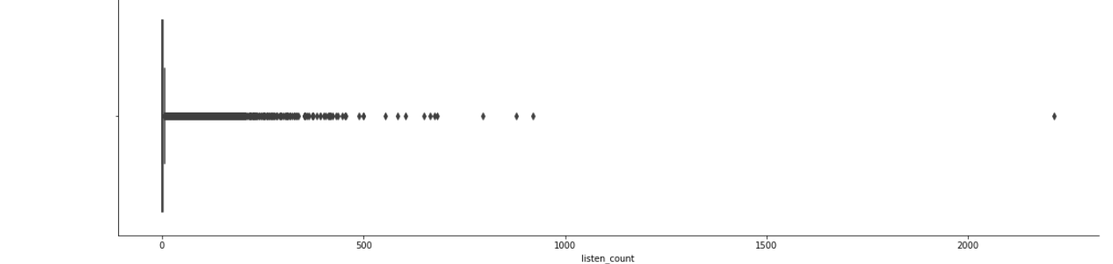
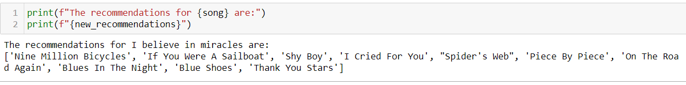
RESULTS
We can also get some other information from the feature listen_count :
Figure : distribution of listen_count
Figure : New Recommendations

Slide 20
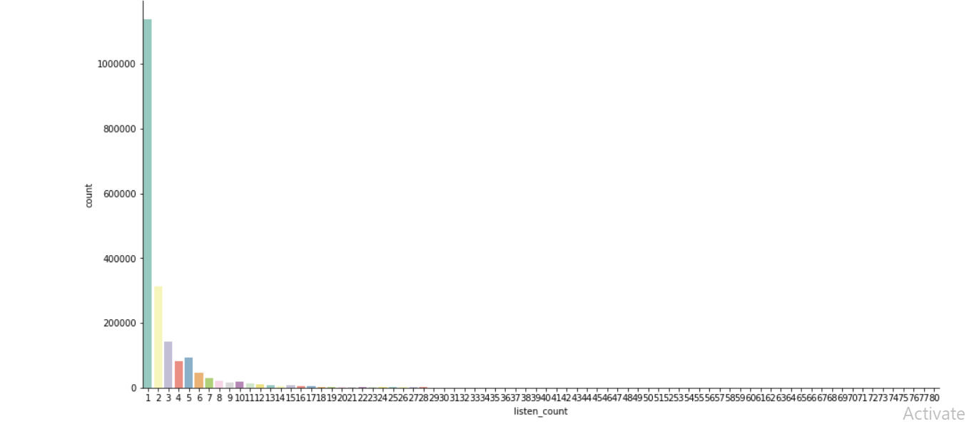
RESULTS
Figure : most frequent number of times a user listen to the same song

Slide 21
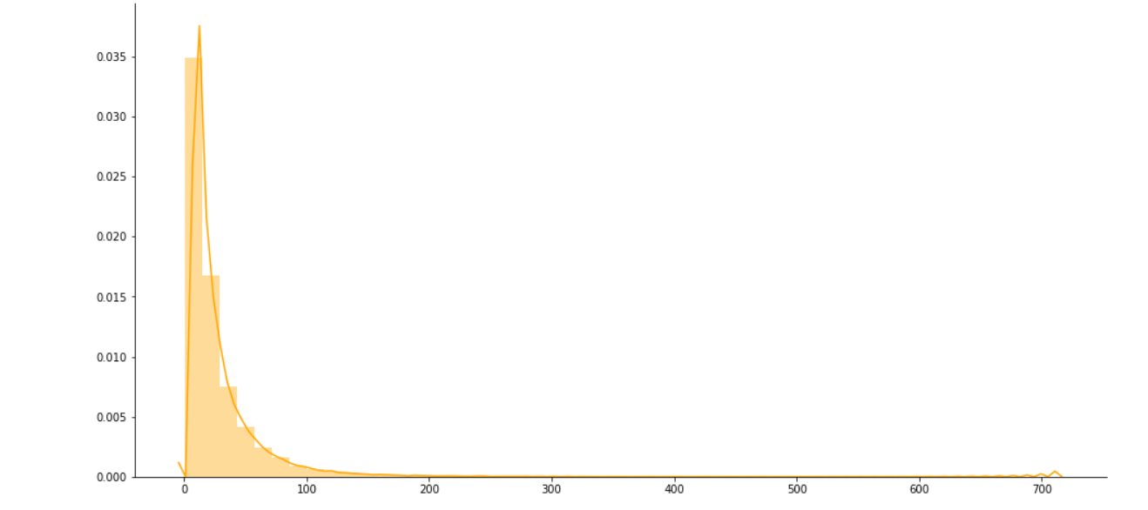
RESULTS
Figure : songs user listen in average

Slide 22
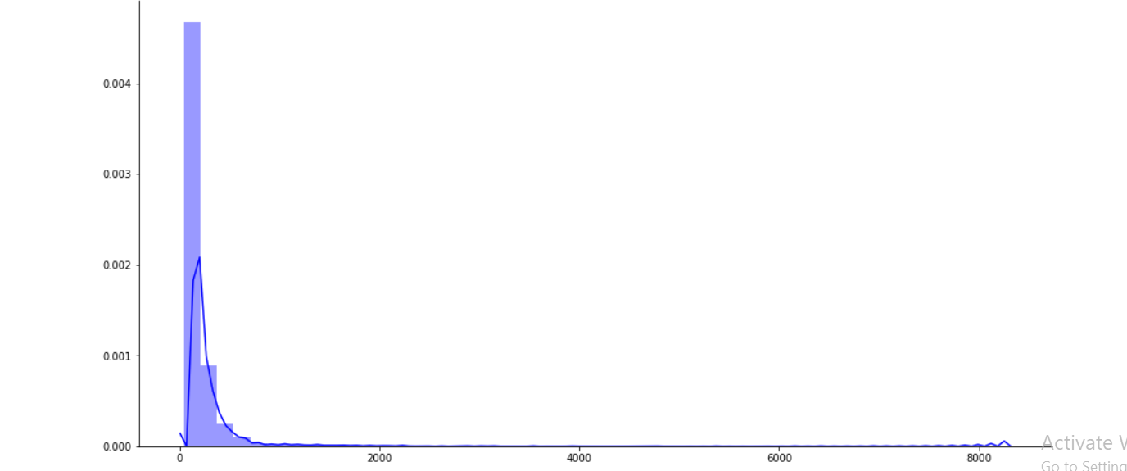
RESULTS
Matrix factorization method (using SVD ) :
Figure : number of users listen to same song on average

Slide 23
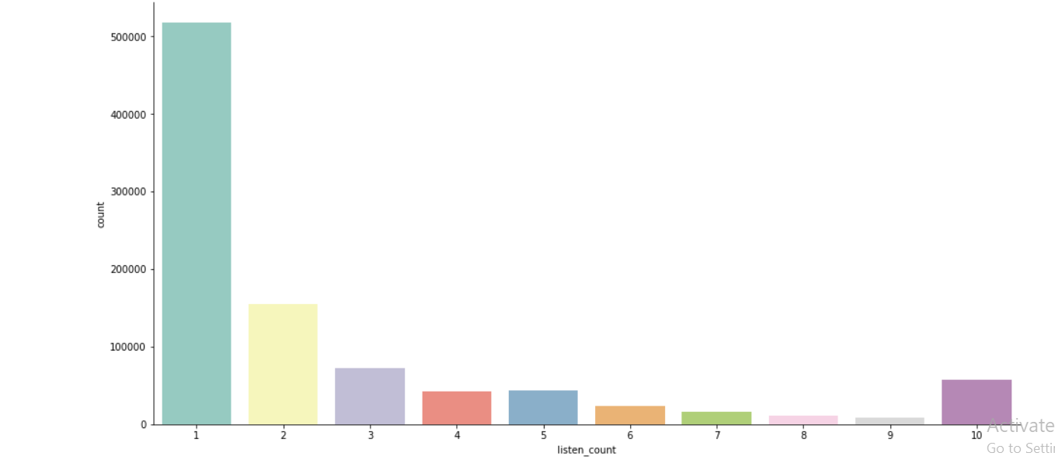
RESULTS
Figure : Listen count of categories divided

Slide 24

Accuracy :
 | Fold1 | Fold2 | Fold3 | Fold4 | Fold5 | Mean | Std
RMSE (testset) | 2.1709 | 2.1768 | 2.1832 | 2.1807 | 2.1653 | 2.1754 | 0.0065
Fit(train) time | 860.41 | 852.93 | 800.15 | 462.58 | 459.12 | 687.04 | 185.85
Test time | 6.27 | 5.17 | 3.03 | 2.36 | 2.73 | 3.91 | 1.53
Table: Testing the Root Mean Square Error of the SVD algorithm with 5 splits
Figure : RMSE of SVD algorithm

Slide 25

CONCLUSION
So, From the above dataframe we can predict that matrix factorisation using SVD Model is result into best score among the three different model.But we try to make our others model accuracy more accurate but at this stage we can see that our problem scoring only with 2.178 RMSE which is given by matrix factorisation using SVD algorithm.

Slide 26
THANKS!
Any questions?

